Slide 1
Git and GitHub

Slide 2
Overview
Setup
Git
GitHub
Group Collaboration in a project
Sharing and versioning source code

Slide 3
Setup
Install Git for Windows
https://git-scm.com/download/win
Signup for GitHub
https://github.com/

Slide 4
Git
Git is a free and open-source distributed version control system for tracking changes in source code and is used for software development.
Notes:
Git is a free and open-source distributed version control system for tracking changes in source code and is used for software development. It was created by Linus Torvalds (creator and developer of Linux) in 2005. It allows you to record changes in your file over time so that you can access specific versions of your file later on. Moreover, you can also coordinate with several people working on a single file or files with the help of git. So git is basically a content tracker.

Slide 5
GitHub
Git is a version control system that lets you manage and keep track of your source code history.
GitHub is a cloud-based hosting service that lets you manage Git repositories.

Slide 6
Creating a repository
Your repository is where you’ll organize your project. You can keep folders, files, images, videos, spreadsheets, Jupyter notebooks, data sets, and anything else your project needs.
Notes:
Before you can work with Git, you have to initialize a repository for your project and set it up so that Git will manage it.
Now in terms of git, a repository is the .git/ folder inside a project. This repository tracks all changes made to files in your project, building history over time. Meaning, if you delete the .git/ folder, then you delete your project’s history.

Slide 7
Creating a repository in GitHub
GitHub website, look in the upper right corner, and click the + sign and then click “New repository.
Name the repository, and add a quick description.
Decide whether you want this to be a public or a private repository
Select “Initialize this repository with a README” option if you want to include the README file.
Notes:
README file the first thing people are going to look at when they check out your repository. It’s also a great place to put information that you need to have in order to understand or run the project

Slide 8
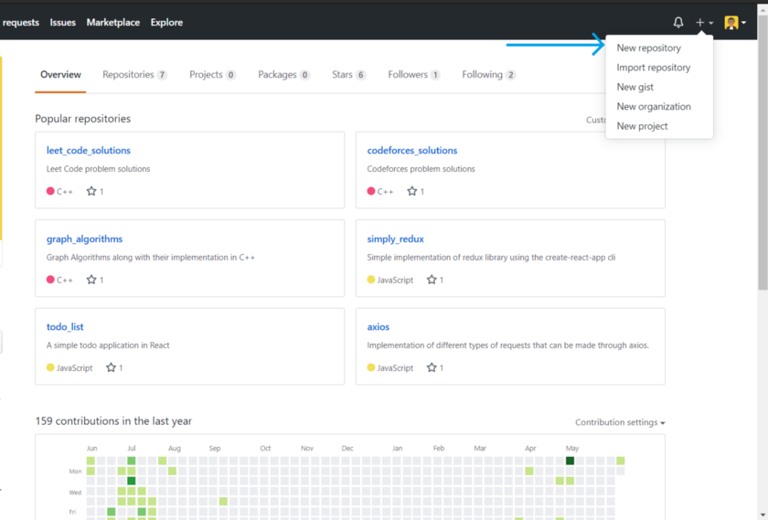

Slide 9
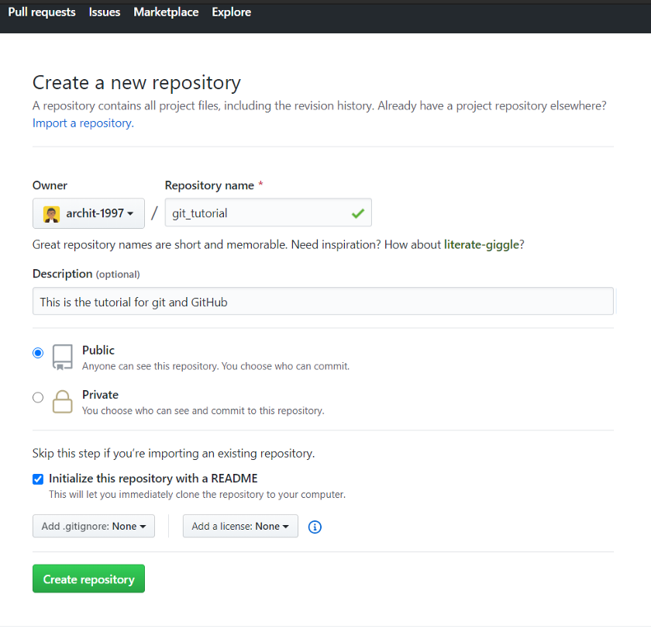

Slide 10
Create a repository using git CLI
Head over to the folder where you want to create a repository and create a folder with the respective name.
Go into the directory
Type git init

Slide 11
Cloning a repository
If a project has already been set up in a central repository, the git clone command is the most common way for users to obtain a development copy.
The git clone command copies an existing Git repository.
To clone a repository means that you’re taking a repository that’s on the server and cloning it to your computer — just like downloading it. On the repository page, you need to get the “HTTPS” address.

Slide 12
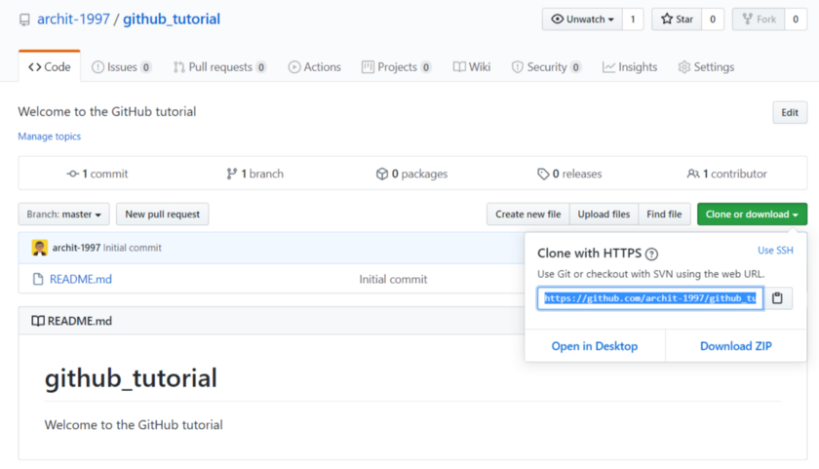

Slide 13
Cloning a repository
Copy the address and use the following command on your terminal or command line.
git clone "http-address that you have just copied“
Now your repository is on your system and you can move in with the following command:
cd "repository-name“

Slide 14
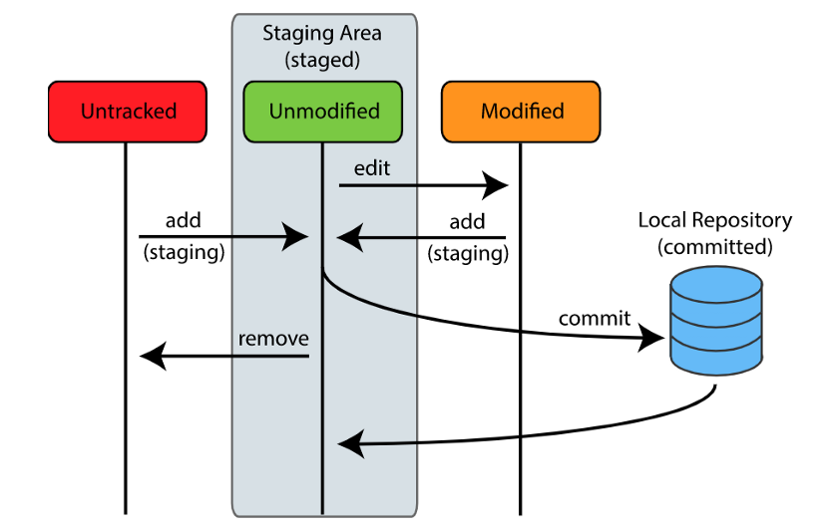
The three states and areas of git

Slide 15
The three states and areas of git
A file in git can only have three states, namely :
Committed
Committed means that Git has officially taken a snapshot of the files in the staging area, and stored a unique index in the Git directory.
modified/ untracked
Git views untracked and modified files similarly. Untracked means that the file is new to your Git project. Modified means that the file has been seen before, but has been changed, so is not ready to be snapshotted by Git. Modification of a file occurs in your working directory.
Staged
When a file becomes staged, it’s taken into the staging area. This is where Git is able to take a snapshot of it and store its current state to your local repository.
Notes:
The term for the very last snapshot you’ve made for commitment is known as the HEAD.

Slide 16
Basic Version Control
Navigate to the directory in which you had cloned the repository “github_tutorial” (you can use any other name as well) using the standard “cd” command. Now you can initialize a git repository with the following command:
>> git init
This creates a new subdirectory named .git that contains all of your necessary repository files — a Git repository skeleton. At this point, nothing in your project is tracked yet.

Slide 17
Adding files
To add this file, enter the following command:
>> git add "file-name“
The git add command adds a change in the working directory to the staging area. It tells Git that you want to include updates to a particular file in the next commit.
Notes:
To start versioning new or any existing files, you should start by tracking those files and doing an initial commit. To accomplish that, you start by adding the files to git that you would like to be attached to your git project.
As of now, you won’t be having any file in this repository because you haven’t created any. So, create a sample text file in the very same directory and name it test.txt

Slide 18
Adding multiple files
If you want to add multiple files with a single command, use the git add command followed by a list of space-separated file names.
>> git add "file-name-1" "file-name-2" "file-name-3“
To add the files in your working directory, you can use the following command :
>> git add --all

Slide 19
Check Status
You can see check the current state of the working directory and the staging area using the following command:
>> git status
Notes:
This lets you see which changes have been staged, which haven’t, and which files aren’t being tracked by Git. The status output does not show you any information regarding the committed project history. For this, you need to use git log

Slide 20
Commit in git
If you want to commit all the files to the local repository with the same comments, then you can use the following command :
>> git commit -am "comments-text“
So now, the changes that you had made in your working directory have been updated in your local repository as well.

Slide 21
Pushing updates to the GitHub repository
The git push command is used to upload local repository content to a remote repository.
>> git push origin master
Notes:
Now you have to update the remote repository also with the respective changes. For this purpose, we use the git push command. The git push command is used to upload local repository content to a remote repository. Pushing is how you transfer commits from your local repository to a remote repo. After a local repository has been modified a push is executed to share the modifications with remote team members.
git push origin mastergit push origin master will push your changes to the remote server. “master” refers to the master branch in your repository.If you want to push your changes to any other branch (say test-branch), you can do it by:
git push origin test-branch

Slide 22
References
https://medium.com/the-underdog-writing-project/introduction-to-git-and-github-a5fdf5633923

